Slide 1
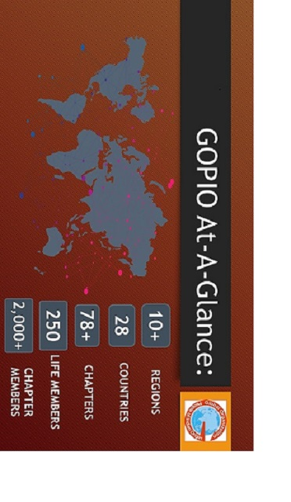
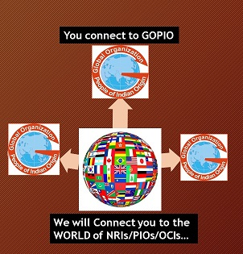
Central Jersey Chapter
GOPIO INTERNATIONAL AT A GLANCE
GLOBAL ORGANIZATION OF PEOPLE OF INDIAN ORIGIN (GOPIO)
Central
New Jersey Chapter
GOPIO CENTRAL JERSEY MEMBERSHIP
Permanent Individual: $200.00
Permanent Family: $300.00
Check payable to:
GOPIO of Central Jersey
Mail checks to Attn:
Mr. Nishith Mehta, VP
1600 Route 130,
North Brunswick, NJ 08902
Global Indian Communities:
Time is now for Unity
Website: gopio-nj.com
Email: Gopio-cj@googlegroups.com
Phone: (732) 939-6843
Address: 1600 Route 130, North Brunswick, NJ 08902

Slide 2
GOPIO’s MISSION
GOPIO HISTORY
GOPIO – Central Jersey
Membership Form
GOPIO International was formed in 1989 at the first convention of PIOs held in New York
GOPIO is active in 28 countries with over 78 chapters around the globe.
Recent Annual Global Conventions were held in Zurich, New York, New Delhi, Mumbai and Hyderabad, Trindade , Bahrain.
GOPIO has been campaigning for issues of interest to the Indian community on Capitol Hill and at the European Union as well as with the Govt. of India, MOE, etc.
To promote the wellbeing of People of Indian Origin (PIO) and to enhance cooperation and communication between PIOs and other communities.
Required Details:
Name: ______________________
E-mail: ______________________
Company (Optional): _____________
Address: _____________________
___________________________
City: ________________________
State: ________ Zip __________
Tel (H) ______________________
Tel (W) ______________________
Tel (C): ______________________
Optional Details:
Partner’s Name: ________________
DOB (DD/MM): ________________
Anniv. Date (DD/MM): ___________
How did you learn about GOPIO of CJ:
Introduced by member
Website
Newspaper Article
Other: __________________
GOPIO’S GOALS
Present and promote the interest of India and PIOs, and help shape relevant policies
Promote better understanding of Indian history, culture and customs
Mobilize the growing professional and intellectual resources of Indian Americans for economic and social programs beneficial to the community
GOPIO OF
CENTRAL JERSEY
GOPIO Central Jersey (CJ) Chapter was formed in 2008. GOPIO-CJ serves as a non-partisan, secular, civic and community service organization.
GOPIO – CJ provides a global forum to foster fellowship and enhance networking
& helps promote awareness of Indian culture, customs and contributions of PIOs through community programs, forums, events and youth activities. It seeks to strengthen partnerships and create an ongoing dialogue with local communities.

